Slide 1
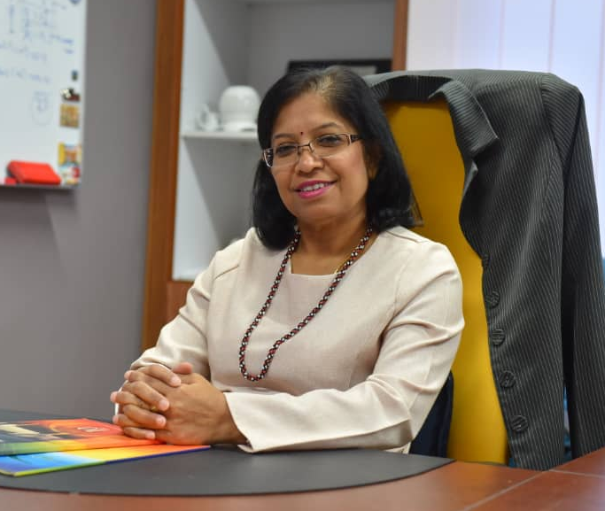
THE PAST, PRESENT AND FUTURE OF UNIVERSITY ADMINISTRATORS: UTM SCENARIO
Punithavalli Marimuthu
Deputy Registrar, UTM International

Slide 2
Content
A Glimpse of UTM Administrators
Future Challenges
Recommendation
Conclusion
Current HE Scenario

Slide 3
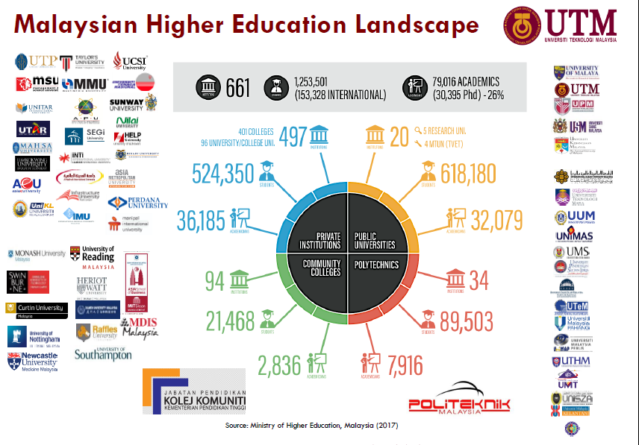

Slide 4
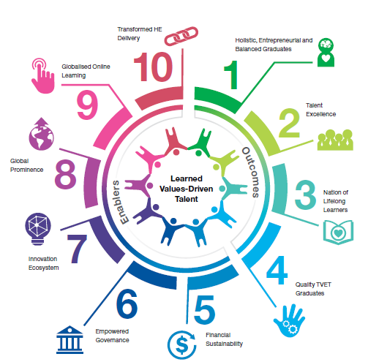
10 Shifts of Malaysia Education Blue Print

Slide 5
DESIRED STATE BY 2020
Excellence &
Distinction
Highest Quality
Teaching and learning
Maintaining SETARA rating
(6 STAR)
QS World University Rankings
Global Top 50
(Engineering and Technology)
Value-Driven
High Performance
5 star rating (MAMPU)
Total Unified Effort toward
Universal Prosperity and Well-Being
Widened and
Democratised Access
Intensified TNE, flexible education,
increased and diversified financial support
Holistic, Entrepreneurial and Balanced Graduates
95% graduates being employed or become entrepreneurs
Driving Industry and Community
Well-being and prosperity via teaching and learning, research and services
RM
RM
Translational
Research University
6 star rating in MyRA
University 4.0
Humanising 4IR using 21st century curriculum to empower people
via digital economy
Institutional Sustainability
People, governance, financial and reputation
Notes:
People, governance, financial and reputation
Higher education is so dynamic we revise our Desired State. Pushing ahead and to ensure we prepare for UTM enVision 2025
To be ahead, relevant,

Slide 6
#228 (WUR) #53 (E&T) #18 (Under 50) #49 (Asian) | QS WU Rankings (2018)
5 subjects in Top 100 | QS Ranking by subjects
6 Star Rating | MyRA
4 | HiCoEs
80% | Graduate employability rate
UTM Now
Reputation
Admission/Enrolment
21,323 | Total UG & PG enrolment
9,273 | Total PG enrolment
4,838 | Master students
4,363 | PhD students
2,446 | Total international students
*Source: SMO UTM (MyMohes data; cut off:10 Oct. 2016)
cut off: July 2018)
Alumni
THE CYCLE OF
180, 425 | Total alumni
7,151 | International alumni
70 | Countries
EXCELLENCE
Total Campus Experience
Industry Linkages/Branding
11,128 | Outbound mobility students
5,267 | Inbound mobility students
5,672 | Students involved in ongoing entrepreneurship projects
3,102 | Students involved in Job on Campus programme
2,993 | Students involved in Service Learning programme
141 | Students involved in 5ETP
1,213 | Industry linkages
479 | Community engagement projects
RM8mil | Community engagement fund since 2014
RM469mil | Research grants secured (2010-Sept 2016)
RM4.31mil | Income from research & innovation (Jan-Sept 2016)
16,809 | Indexed publications (2011-Sept 2016)
54,761 | Citations (2010-2016)
Notes:
In short I think we have developed

Slide 7
A Glimpse of UTM Administrators
Future Challenges
Recommendation
Conclusion
Current HE Scenario

Slide 8
University Administrators
Category of non-teaching professionals who render all kinds of professional support services towards promoting the core business of teaching and research in universities.
Work within both the central administrative (academic registrars) department and for individual faculties of universities and other higher education establishments.
There is no ‘typical' job profile: administrators may have roles in student recruitment, funding, quality assurance, marketing or public relations; or they may be responsible for budgetary/financial administration, project management or human resources management.

Slide 9
University Administrators
Non-Academics Staff Administration Staff
Support Staff (Staf Sokongan)
Pengurusan, Profesional & Pelaksana (PPP) Staff
Concerns regarding the nomenclature of university administration in Australia and the UK have featured in the higher education literature for over a decade. In response, a significant nomenclature shift is occurring, with Australian universities replacing the term ‘General Staff’ to describe all administrative and technical staff, in favour of ‘Professional Staff’. [The rise of ‘professional staff’ and demise of the ‘non-academic’: a study of university staffing nomenclature preferences (2012), Darlene Sebalj , Allyson Holbrook & Sid Bourke)

Slide 10
Roles of UTM PPPs
80s and 90s
2000s
2010s
HR and Office Administration
Academic Administration
Student Management
Facility Management
ICT Management
Financial Management
Research Management
Innovation Management
Quality & Risk Management
External Linkages / Alumni Management
Financial Sustainability / Endowment Management
Counselling / student welfare
Strategic Management
Branding
Institutional Research
Technology Transfer
Entrepreneurial
Global / Internationalization
Data Management
Concurrent with institutional developments, non-academic staff’s role and duties, is increasingly complicated and no longer limited to general office work (Graham, 2012; Jisun and Jung, 2015).

Slide 11
Current UTM PPPs Landscape
Groupings (kumpulan)
Pengurusan & Profesional (41- 54)
Pelaksana (1-40)
17 Schemes
JB Campus – 80%
KL Campus – 18%
Pagoh – 2%
P&P – 16%
Pelaksana – 84%
Ratio 1 : 5.3
97.7%
Permanent
Classification
Non - Technical
(E, G, H, KP, L, N, W, S)
Technical (specialized)
(B, C, DV, F, J, Q, U)
3264

Slide 12
Current PPP Landscape
Campus | JOHOR BAHRU |  | KUALA LUMPUR |  | PAGOH | Total
Scheme | Contract | Permanent | Contract | Permanent | Permanent
B | 1 | 29 |  | 4 |  | 34
C |  | 134 |  | 14 | 1 | 149
D | 1 | 25 |  | 14 |  | 40
E | 1 |  |  |  |  | 1
F | 4 | 147 | 1 | 19 | 2 | 173
G |  | 5 |  |  |  | 5
H |  | 124 |  | 70 |  | 194
J | 1 | 432 |  | 93 | 13 | 539
K | 4 | 143 | 6 | 64 | 2 | 219
L |  | 3 |  |  |  | 3
N | 31 | 1097 | 8 | 211 | 11 | 1358
Q | 2 | 79 | 3 | 9 | 23 | 116
R |  | 5 |  |  |  | 5
S |  | 181 |  | 42 | 3 | 226
U |  | 44 | 1 | 11 |  | 56
V |  | 3 |  |  |  | 3
W | 8 | 110 |  | 22 | 3 | 143
Grand Total | 53 | 2561 | 19 | 573 | 58 | 3264

Slide 13
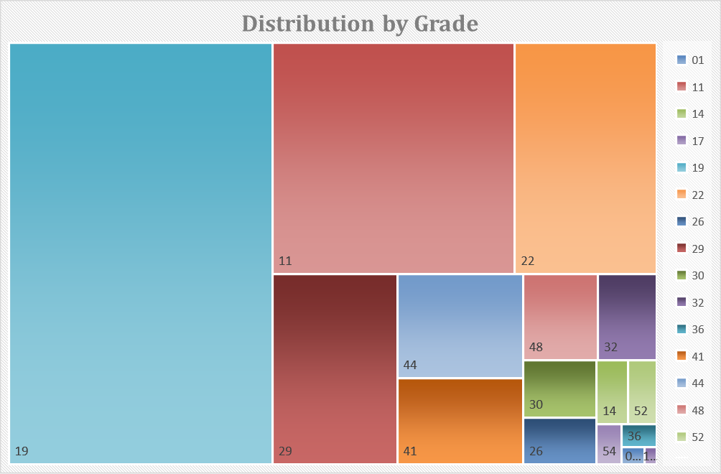
Distribution by Scheme and Grade
01 | 11 | 14 | 17 | 19 | 22 | 26 | 29 | 30 | 32 | 36 | 41 | 44 | 48 | 52 | 54
0.1% | 20.5% | 0.7% | 0.1% | 40.7% | 12.0% | 1.3% | 8.7% | 1.5% | 1.8% | 0.3% | 4.0% | 4.8% | 2.4% | 0.7% | 0.4%

Slide 14
Academic Staff vs PPP

Slide 15
Administrator (>41) Profile
Sch | 41 | 43 | 44 | 48 | 51 | 52 | 54 | VU06 /07 | Total
E | 1 |  |  |  |  |  |  |  | 1
K | 1 |  | 1 | 1 |  |  |  |  | 3
L | 2 |  |  |  |  |  | 1 |  | 3
B | 2 |  | 2 |  |  |  |  |  | 4
U |  | 4 | 1 |  | 1 | 1 | 2 |  | 9
C | 8 |  | 11 |  |  |  |  |  | 19
W | 18 |  | 9 | 4 |  | 3 | 2 |  | 36
J | 18 |  | 18 | 9 |  | 1 | 1 |  | 47
F | 8 |  | 38 | 2 |  | 4 | 1 |  | 53
S | 25 |  | 32 | 11 |  | 4 | 2 | 1 | 75
Q | 75 |  | 30 | 2 |  |  |  |  | 107
N | 54 |  | 65 | 32 |  | 9 | 5 | 2 | 167
Grand Total | 212 | 4 | 207 | 61 | 1 | 22 | 14 | 3 | 524

Slide 16
Administrator (>41) Profile
Distribution is very random. Must have clear career path

Slide 17
A Glimpse of UTM Administrators
Future Challenges
Recommendation
Conclusion
Current HE Scenario

Slide 18
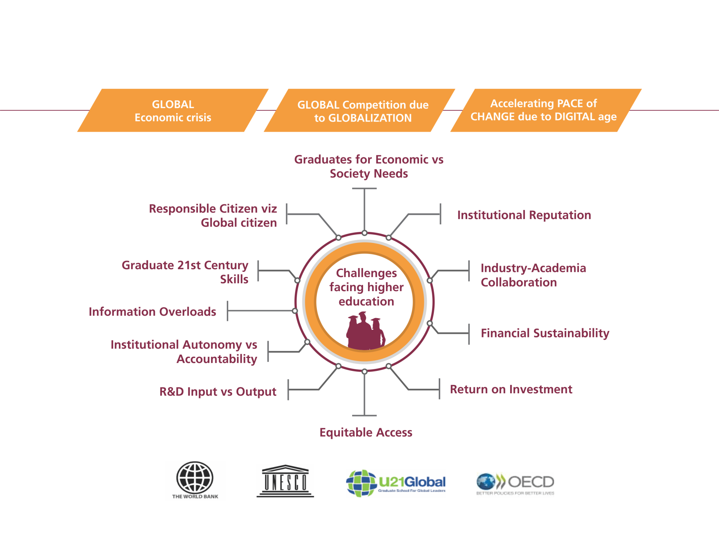
Environmental Scanning
Source: Mohd Salleh Jaafar . (2017). Transforming Malaysian Higher Education: 2025 and Beyond.
Seminar Pelan Global UTM 2012-2020 (Fasa III: 2018-2020), Seminar Hall CICT, Universiti Teknologi Malaysia (UTM)

Slide 19
ENVIRONMENTAL SCANNING
Source: Abdul Rahim Hashim. (2017). Preparing graduates for the 4th Industrial Revolution.
Plenary forum presented at the 7th World Engineering Education Forum 2017, Kuala Lumpur, Malaysia.

Slide 20
DESIRED STATE BY 2025
Excellence &
Distinction
Empowered
Student’s learning and
teaching experience
(flexible, personalised, student centered)
QS World University
Rankings
Global Top 100 and Global Top 20
(Engineering and Technology)
Value-Driven
High Performance
5 star rating (MAMPU)
Total Unified Effort toward
Universal Prosperity and Well-Being
Widened and
Democratised Access
Intensified TNE, flexible education,
increased and diversified financial support, equity
Holistic, Entrepreneurial and Balanced Graduates
95% graduates being employed or become entrepreneurs
Driving Industry and Community
Well-being and prosperity via teaching and learning, research and services
RM
RM
Translational
Research University
Beyond MyRA, high impact,
beyond borders
University 4.0
Humanising 4IR using 21st century curriculum to empower people
via digital economy
Institutional Sustainability
People, governance, financial and reputation
Notes:
Bagaimana nak capai nii??

Slide 21
Future UTM Administrators

Slide 22
A Glimpse of UTM Administrators
Challenges
Recommendation
Conclusion
Current HE Scenario

Slide 23
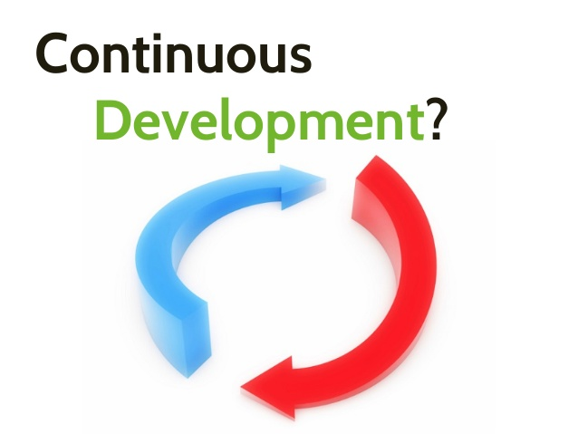
1. Continuing Education

Slide 24
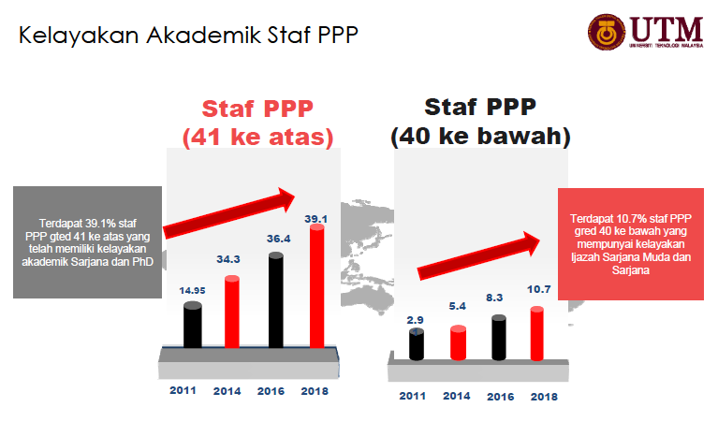
Current Staff Development Trend

Slide 25
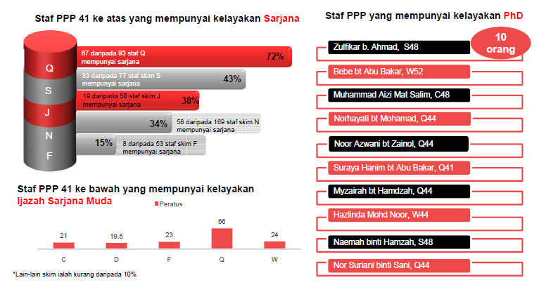

Slide 26
PPPs ON STUDY LEAVE
(2015 – 2018)
 | 2015 | 2016 | 2017 | 2018
PhD | 10 | 10 | 14 | 11
MSc | 6 | 5 | 6 | 5
 | 10 | 15 | 20 | 16

Slide 27
Attachment and OJT (2015-2018)
2016
D N : 2
L N : 9
2018
11
D N : 1
L N : 6
2017
7
D N : 10
L N : 9
2015
19
D N : 5
L N : 2
7
Jumlah : 44
DN-Dalam Negara
LN – Luar Negara
Data Sehingga: 31 Julai 2018

Slide 28
Strategic Posts of UTM Administrators
Scheme | No. of Strategic Post
Pentadbiran (N) | 21
Kejuruteraan (J) | 9
Pustakawan (S) | 5
Kewangan (W) | 8
Teknologi Maklumat (F) | 8
Total | 51
TTC prioritize strategic posts for succession plan

Slide 29
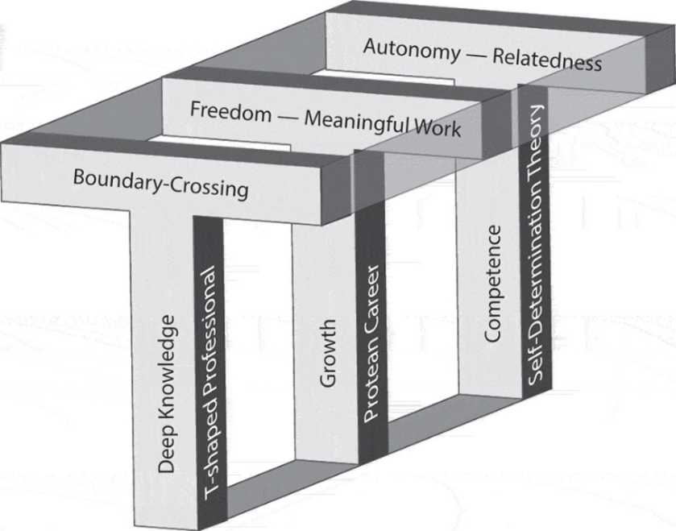
Continuing Education: Tertiary Education Administrator
Non-Technical Scheme – especially ‘N’
Fill-in-the-gap
Formally trained as TE Administrators or HE Administrators
Why TE?
The model suggest ‘T-shaped professional is worthwhile for TE managers in the current climate of unceasing transformation now to help identify any gaps in your own repertoire, made visible by the horizontal part of the T’
Career paths for VUCA conditions and knowledge work need to be more ‘multidirectional, dynamic and fluid’
One can be shaped either like an "I” (think narrow and tight) or a "T" (think extended). The I-shaped professional is highly versed in a specific area of expertise and learns by drilling more deeply into a particular field. The T-shaped person has broader skills and knowledge and learns by linking up different perspectives from different specialties.
Blueprint for development
This terminology of ‘I’ and ‘T’ apparently originated at McKinsey & Company

Slide 30
2. Rise of Third Space Professionals
PPPs assuming more ‘project’ based roles especially the technical schemes such as Q, C, J etc
Motivated to acquire academic credentials Masters and PhD.
This creates Third Space between professional and academic spheres in which lateral interactions, involving teams and networks, occur in parallel with formal institutional structures and processes, and give rise to new forms of management and leadership. [Reconstructing Identities in Higher Education: The rise of 'Third Space' professionals (2012), Celia Whitchurch]
The university should make them more visible and provide opportunities to lead. Studies shows that some professional staff has been appointed as Pro-VC and Deputy VC.

Slide 31
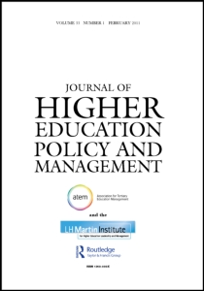
3. Communication and Collaboration
Less conflicts
Need to bridge the gap between administrators and academic staff
Communicate and collaborate effectively with both parties
Translate by sharing your thoughts via HE platforms such as dialogues, seminars and paper publications

Slide 32
4. Affiliation with Professional Bodies
Association of University Administrators

Slide 33
27 Feb 2001
Comprises of all 20 IPTA associations of administrators such as UTM – PERTISAS, USIM -PRAGMATIS, UMT -PERENTAS, UM - PEKERTI, UiTM – PPUiTM, PRESTASI – UPSI, PERTADI – UKM, PPUMS - UMS, PMA – UIAM, PRAKTIS – UTEM, PPTI – UMP, PENGEMUDI – UNISZA, PERPATI – UUM, POTENSI – UNIMAP< PENTAS – UTHM, PERTISA – UMK, GPUSM – USM, PPUPM – UPM etc
20 August – Hari Pentadbir Universiti
Foster collaboration with all administrators
Majlis Persatuan Pentadbir
Universiti Awam Malaysia

Slide 34
A Glimpse of UTM Administrators
Challenges
Recommendation
Conclusion
Current HE Scenario

Slide 35
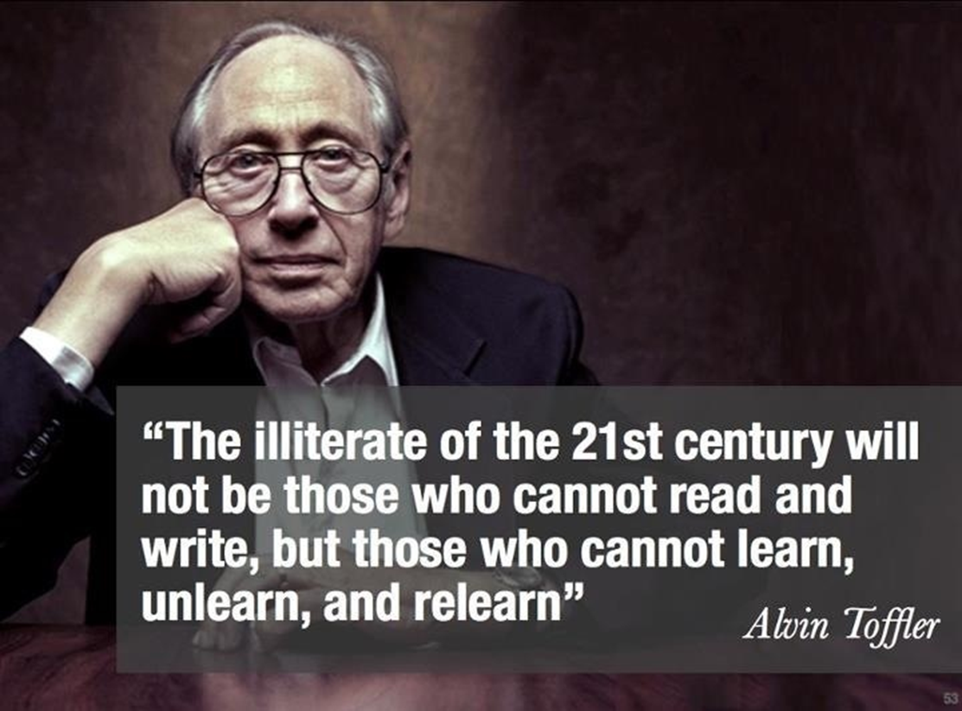
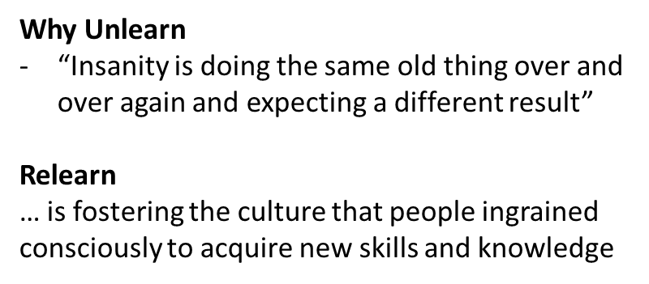
Conclusion

